Slide 1
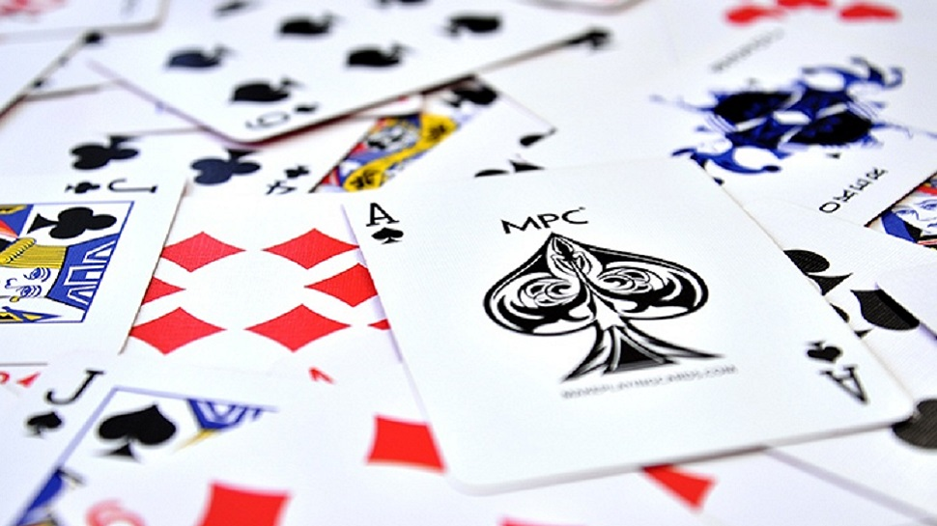
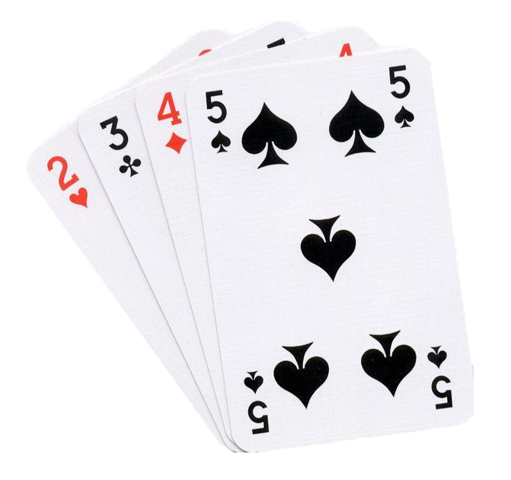
Sorting Cards
(고은서, 구본우, 김건우, 김우진, 박재형, 백박, 손경식, 정승혁)
Team 5
Presentor: 김우진 PPT: 고은서

Slide 2


Divide 15 cards into three sections:
a card sent to the left by me, a card of my range, a card to the right by me.
Arrange the 15 cards you receive in units of 100.
Each person has a specific range of cards in charge.
400-499
200-399
500-599
100-199
600-699
900-999
700-799
800-899

Slide 3
Divide 15 cards into three sections:
a card sent to the left by me, a card of my range, a card to the right by me.
When you're done, put the card on top of your head.

Slide 4
Then, similarly, sends card to the right three times with the captain’s signal.
When everyone finishes organizing, they turn the card to the left in line with the sign from the captain.
Divide the cards you receive into one to the left.
In this way, I send card 4 times to the left with the signal from the captain.
When you're done, put the card on top of your head.

Slide 5
Then, similarly, sends card to the right three times with the captain’s signal.
At the end of this process, you will only have your own category of cards. Arrange all the cards you have.

Slide 6
When the arrangement is finished, share 15 cards.
At the end of this process, you will only have your own category of cards. Arrange all the cards you have.
The End!

Slide 7
* The Pros of This Method *
It doesn’t get confused because one person is in charge of the range.
Since it was first organized into 100 digits, it takes very little time to hand over the cards.
* The Cons of This Method *
If cards are crowded to one side, it is difficult to arrange later.
This is because one person has to arrange a very large number of cards.
This is why our team took a long time, we think.

Slide 8
*The way our team wrote numbers on the cards*
- One we wrote down 90 cards from 900 to 999.
- Other we wrote each 20 cards from 640 to 649, from 660 to 669, from 330 to 339, from 350 to 359.

Slide 9
Thank you
for listening

